Slide 1

LIBRARY MANAGEMENT SYSTEM
MERT ALTUNTAŞ – 1804010005
KAAN ÇELİKTAŞ – 1804010013
MAHMUT CAN ASLAN – 1804020005

Slide 2
SYSTEM’S WORKING PRINCIPLE
System is basically based ona a library system and we have two main user :
1. Student
2. Librarian
These users have different options and controls on the system.
LIBRARIAN
STUDENT
EXIT

Slide 3
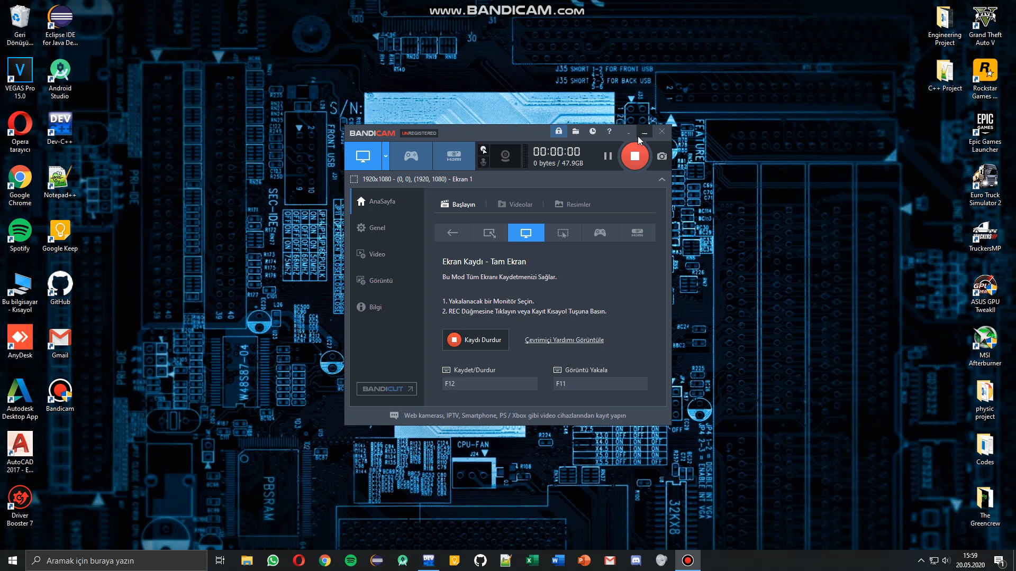
DEMO VIDEO OF THE PROGRAMME

Slide 4
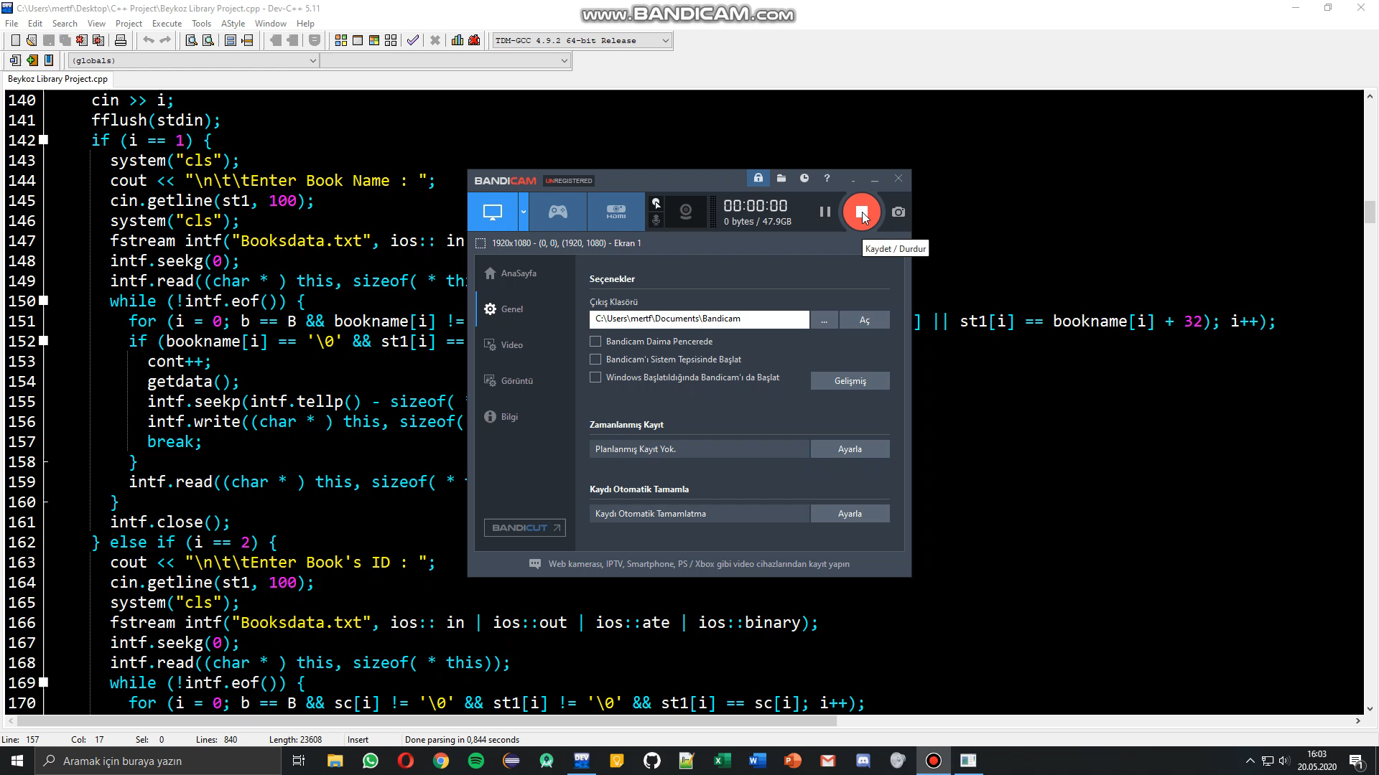
DEMO VIDEO OF THE PROGRAMME

Slide 5
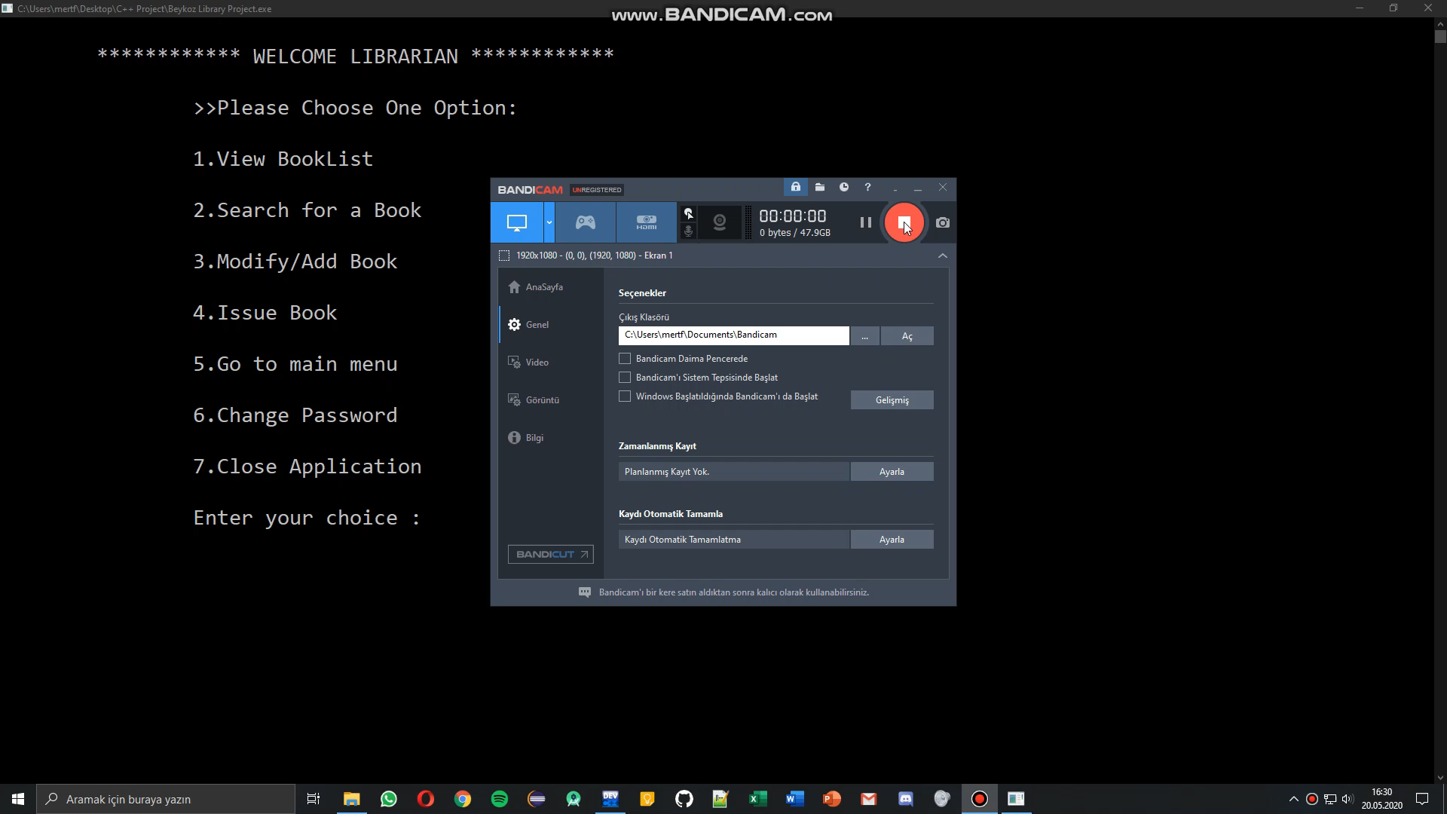
DEMO VIDEO OF THE PROGRAMME

Slide 6
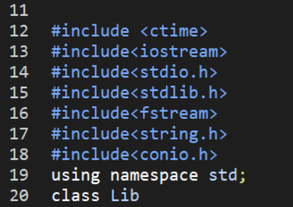
LIBRARIES THAT WE USED IN PROGRAMME
#include <ctime>
#include<iostream>
#include<stdio.h>
#include<stdlib.h>
#include<fstream>
#include<string.h>
#include<conio.h>

Slide 7
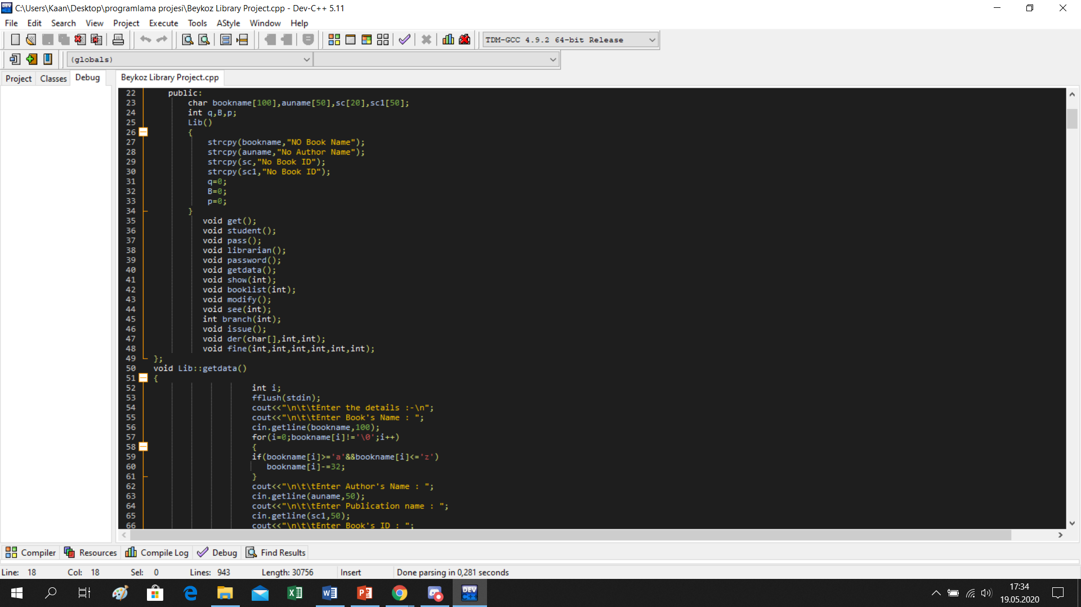
FUNCTIONS THAT WE USED IN PROGRAMME
void get();
void student();
void pass();
void librarian();
void password();
void getdata();
void show(int);
void booklist(int);
void modify();
void see(int);
int branch(int);
void issue();
void der(char[], int, int);
void fine(int, int, int, int, int, int);

Slide 8
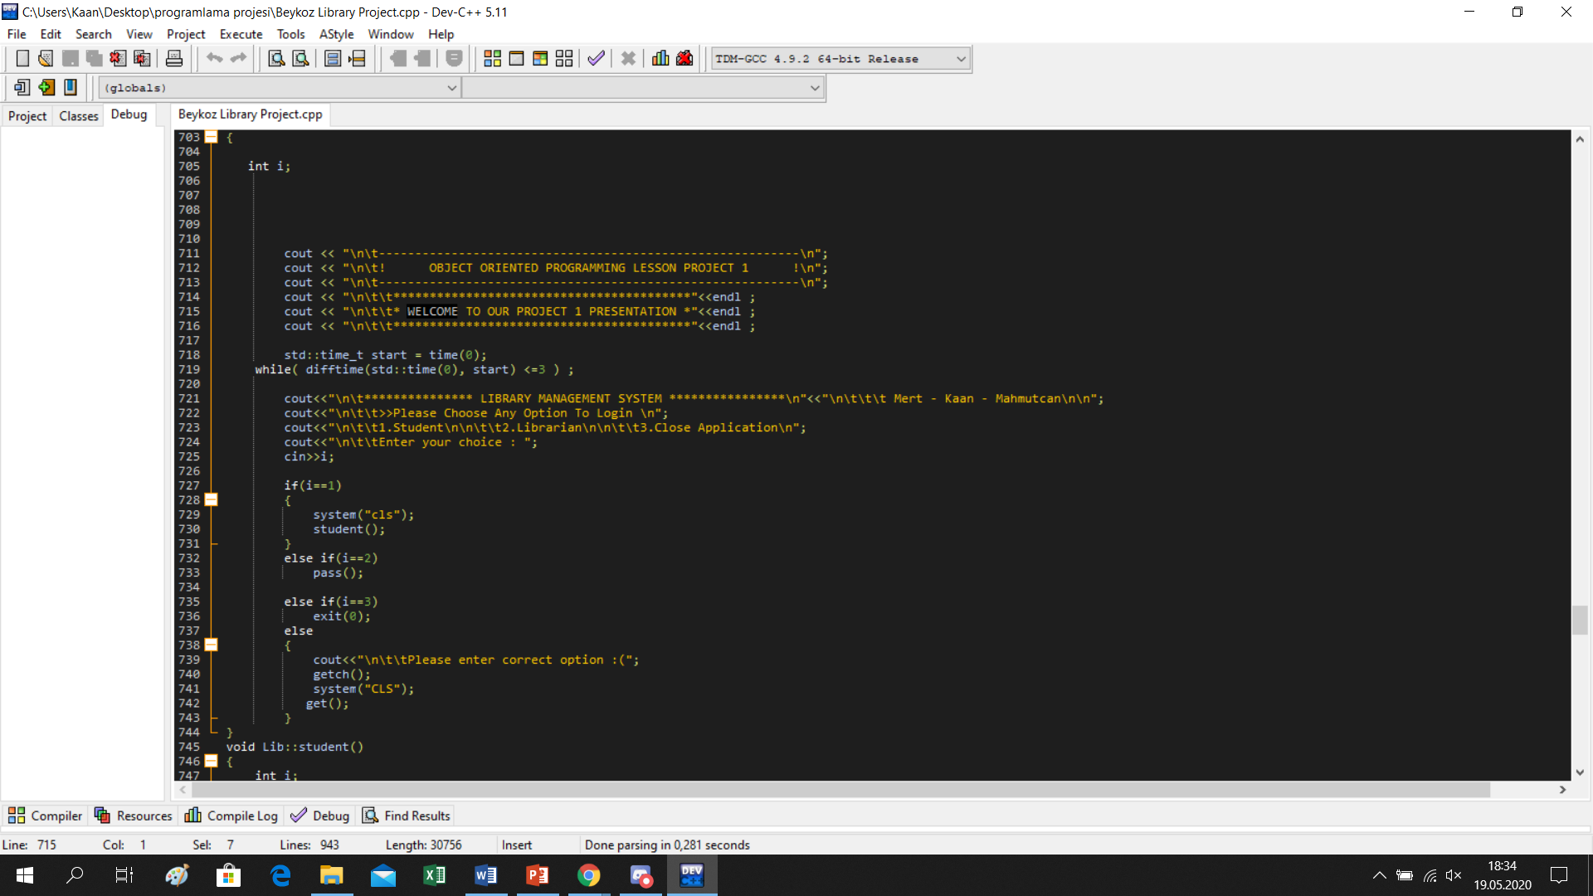
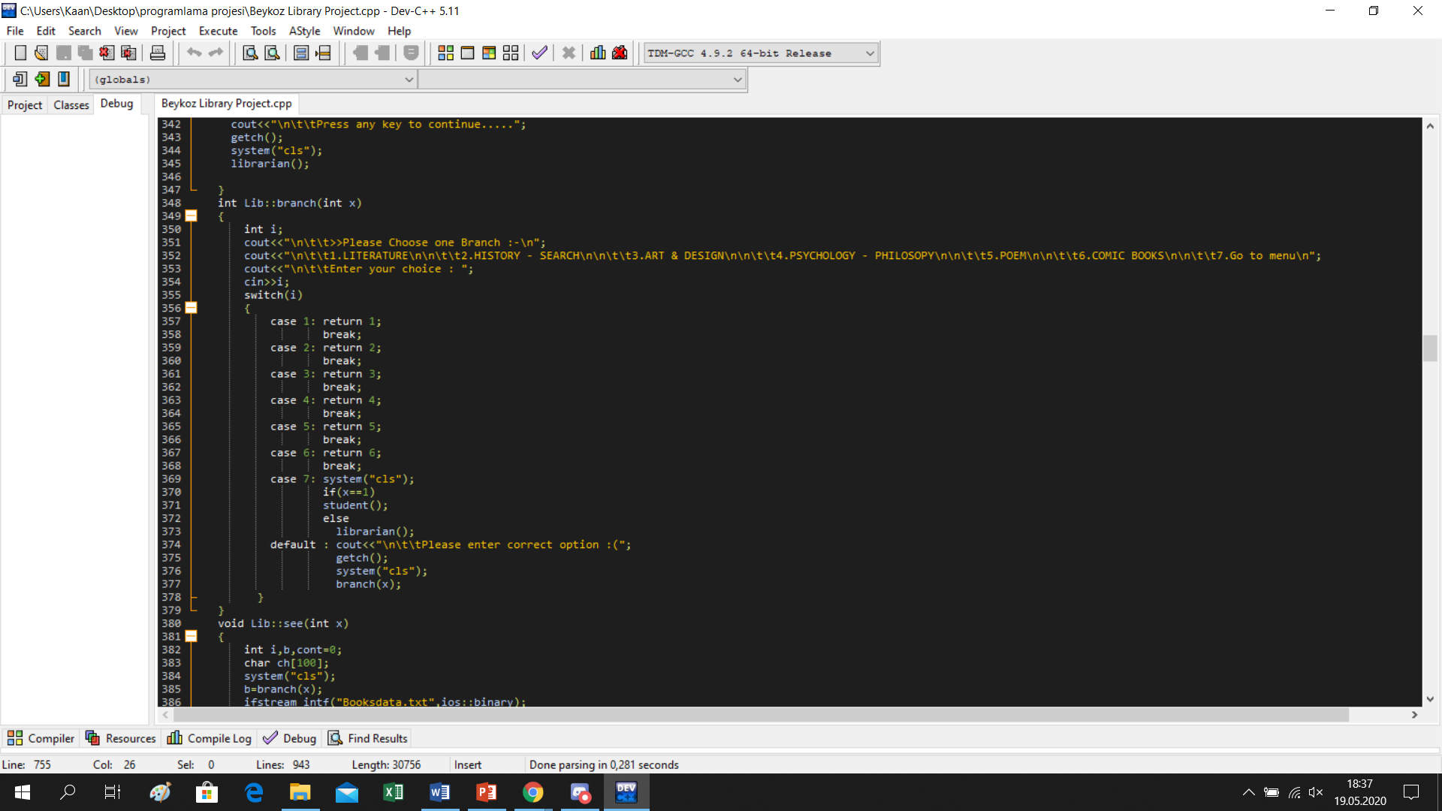
THE MOST IMPORTANT PARTS OF THE CODE
WELCOME PAGE (CTIME)
CATEGORIE PAGE (SWITCH)

Slide 9
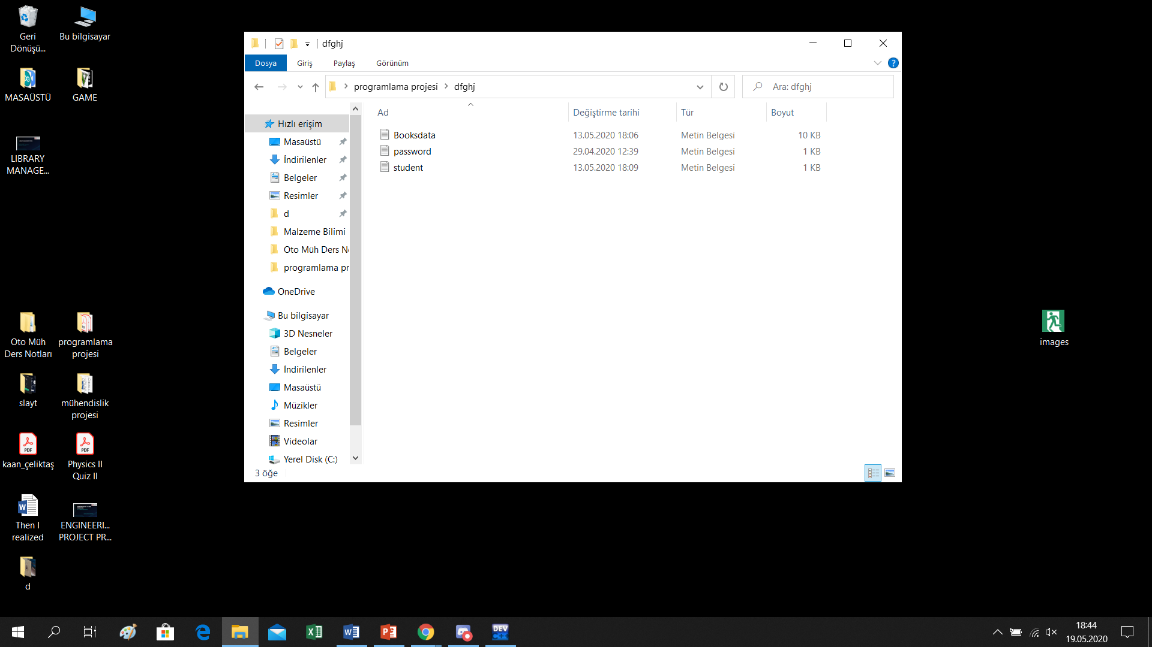
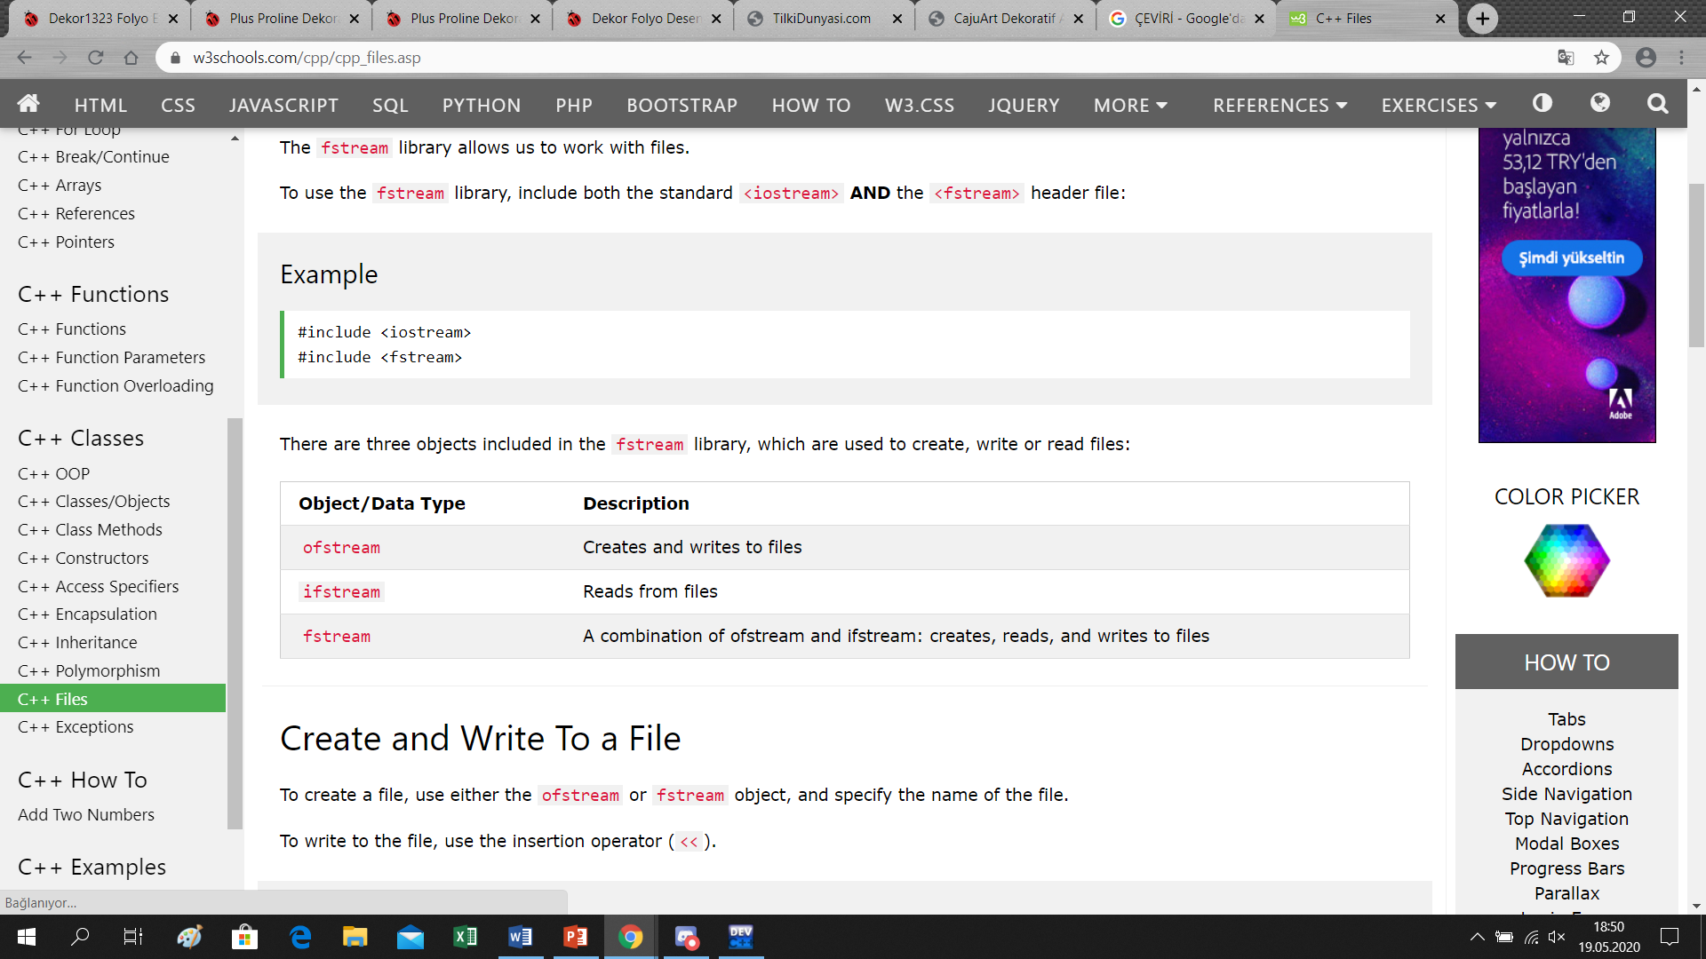
FILES FOR ENTRIES (fstream)
We have different files to keep the datas:
password.txt
student.txt
Booksdata.txt

Slide 10
Thanks for your patıent and lıstenıng

